Slide 1
Cluster Analysis
Cluster analysis is part of the unsupervised learning. A cluster is a group of data that share similar features. We can say, clustering analysis is more about discovery than a prediction. The machine searches for similarity in the data. For instance, you can use cluster analysis for the following application:
Customer segmentation: looks for similarity between groups of customers
Stock market clustering: group stock based on performances
Reduce dimensionality of a dataset by grouping observations with similar values
Clustering analysis is not too difficult to implement and is meaningful as well as actionable for business.

Slide 2
Requirements of Clustering in Data Mining
Scalability − We need highly scalable clustering algorithms to deal with large databases.
Ability to deal with different kinds of attributes − Algorithms should be capable to be applied on any kind of data such as interval-based (numerical) data, categorical, and binary data.
Discovery of clusters with attribute shape − The clustering algorithm should be capable of detecting clusters of arbitrary shape. They should not be bounded to only distance measures that tend to find spherical cluster of small sizes.
High dimensionality − The clustering algorithm should not only be able to handle low-dimensional data but also the high dimensional space.
Ability to deal with noisy data − Databases contain noisy, missing or erroneous data. Some algorithms are sensitive to such data and may lead to poor quality clusters.
Interpretability − The clustering results should be interpretable, comprehensible, and usable.

Slide 3
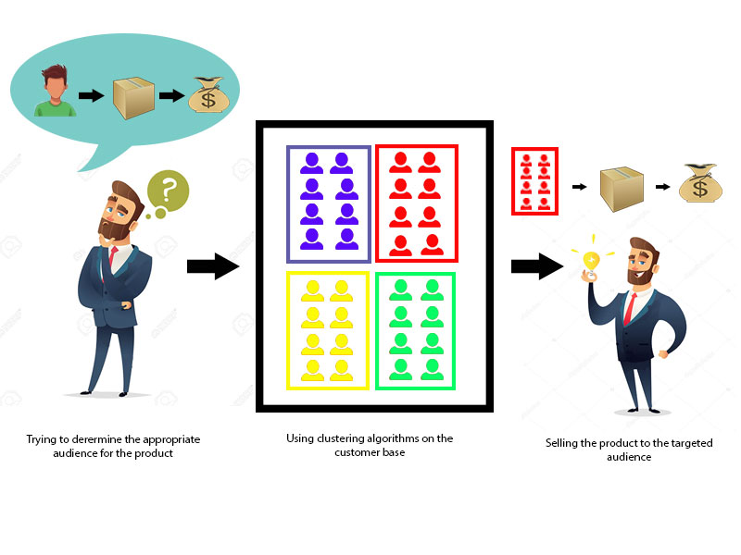
clustering

Slide 4
Categorization of major clustering methods
Partitioning Method
Hierarchical Method
Density-based Method
Grid-Based Method
Model-Based Method
Constraint-based Method

Slide 5
Partitioning Method
Suppose we are given a database of ‘n’ objects and the partitioning method constructs ‘k’ partition of data. Each partition will represent a cluster and k ≤ n. It means that it will classify the data into k groups, which satisfy the following requirements −
Each group contains at least one object.
Each object must belong to exactly one group.

Slide 6
Hierarchical Methods
This method creates a hierarchical decomposition of the given set of data objects. We can classify hierarchical methods on the basis of how the hierarchical decomposition is formed. There are two approaches here −
Agglomerative approach
Divisive approach

Slide 7
Agglomerative Approach
This approach is also known as the bottom-up approach. In this, we start with each object forming a separate group. It keeps on merging the objects or groups that are close to one another. It keep on doing so until all of the groups are merged into one or until the termination condition holds.

Slide 8
Divisive Approach
This approach is also known as the top-down approach. In this, we start with all of the objects in the same cluster. In the continuous iteration, a cluster is split up into smaller clusters. It is down until each object in one cluster or the termination condition holds. This method is rigid, i.e., Once a merging or splitting is done, it can never be undone.

Slide 9
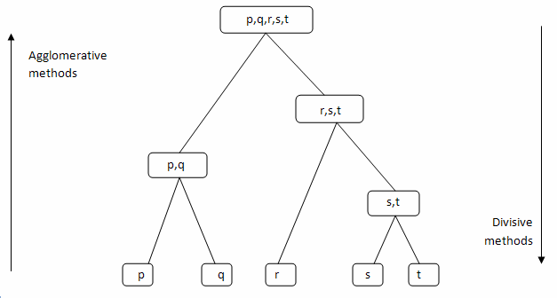
Agglomerative Approach v/s Divisive Approach

Slide 10
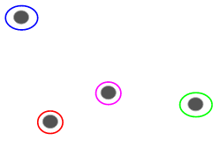
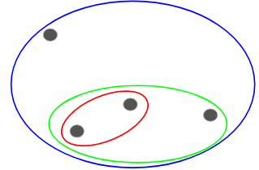
Agglomerative Hierarchical Clustering
We assign each point to an individual cluster in this technique. Suppose there are 4 data points. We will assign each of these points to a cluster and hence will have 4 clusters in the beginning:
Fig 1 Fig 2
Then, at each iteration, we merge the closest pair of clusters and repeat this step until only a single cluster is left:
We are merging (or adding) the clusters at each step, right? Hence, this type of clustering is also known as additive hierarchical clustering.

Slide 11
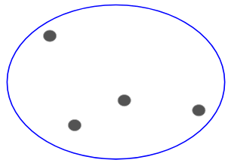
Divisive Hierarchical Clustering
Divisive hierarchical clustering works in the opposite way. Instead of starting with n clusters (in case of n observations), we start with a single cluster and assign all the points to that cluster.
So, it doesn’t matter if we have 10 or 1000 data points. All these points will belong to the same cluster at the beginning:
Figure 1 Figure 2
Now, at each iteration, we split the farthest point in the cluster and repeat this process until each cluster only contains a single point:

Slide 12
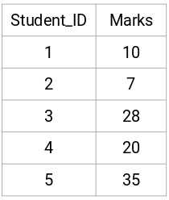
Example
Suppose a teacher wants to divide her students into different groups. She has the marks scored by each student in an assignment and based on these marks, she wants to segment them into groups. There’s no fixed target here as to how many groups to have. Since the teacher does not know what type of students should be assigned to which group, it cannot be solved as a supervised learning problem. So, we will try to apply hierarchical clustering here and segment the students into different groups.
Let’s take a sample of 5 students:

Slide 13
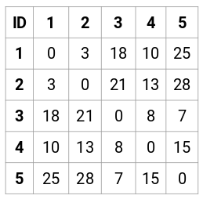
Creating a Proximity Matrix
First, we will create a proximity matrix which will tell us the distance between each of these points. Since we are calculating the distance of each point from each of the other points, we will get a square matrix of shape n X n (where n is the number of observations).
Let’s make the 5 x 5 proximity matrix for our example:
The diagonal elements of this matrix will always be 0 as the distance of a point with itself is always 0. We will use the euclidean distance formula to calculate the rest of the distances. So, let’s say we want to calculate the distance between point 1 and 2:
√(10-7)^2 = √9 = 3
Similarly, we can calculate all the distances and fill the proximity matrix.

Slide 14

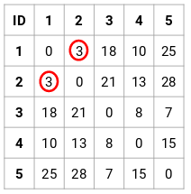
Steps to Perform Hierarchical Clustering
Step 1: First, we assign all the points to an individual cluster:
Different colors here represent different clusters. You can see that we have 5 different clusters for the 5 points in our data.
Step 2: Next, we will look at the smallest distance in the proximity matrix and merge the points with the smallest distance. We then update the proximity matrix:

Slide 15
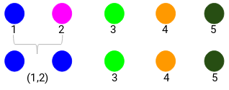
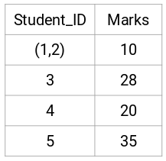
Here, the smallest distance is 3 and hence we will merge point 1 and 2:
Let’s look at the updated clusters and accordingly update the proximity matrix:

Slide 16
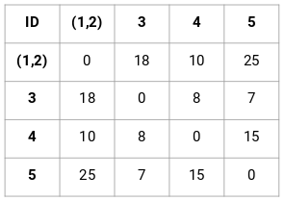
Continued….
Here, we have taken the maximum of the two marks (7, 10) to replace the marks for this cluster. Instead of the maximum, we can also take the minimum value or the average values as well. Now, we will again calculate the proximity matrix for these clusters:

Slide 17
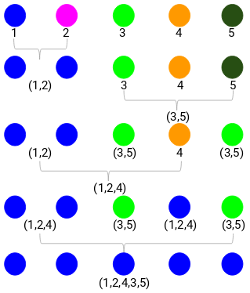
Step 3: We will repeat step 2 until only a single cluster is left.
So, we will first look at the minimum distance in the proximity matrix and then merge the closest pair of clusters. We will get the merged clusters as shown below after repeating these steps:

Slide 18
Density-based Method
This method is based on the notion of density. The basic idea is to continue growing the given cluster as long as the density in the neighborhood exceeds some threshold, i.e., For each data point within a given cluster, the radius of a given cluster has to contain at least a minimum number of points.

Slide 19
Grid-based Method
In this, the objects together form a grid. The object space is quantized into finite number of cells that form a grid structure.

Slide 20
Model-based methods
In this method, a model is hypothesized for each cluster to find the best fit of data for a given model. This method locates the clusters by clustering the density function. It reflects spatial distribution of the data points.

Slide 21
Constraint-based Method
In this method, the clustering is performed by the incorporation of user or application-oriented constraints. A constraint refers to the user expectation or the properties of desired clustering results. Constraints provide us with an interactive way of communication with the clustering process. Constraints can be specified by the user or the application requirement.

Slide 22
Applications of Cluster Analysis
Clustering analysis is broadly used in many applications such as market research, pattern recognition, data analysis, and image processing.
Clustering can also help marketers discover distinct groups in their customer base. And they can characterize their customer groups based on the purchasing patterns.
In the field of biology, it can be used to derive plant and animal taxonomies, categorize genes with similar functionalities and gain insight into structures inherent to populations.
Clustering also helps in identification of areas of similar land use in an earth observation database. It also helps in the identification of groups of houses in a city according to house type, value, and geographic location.
Clustering also helps in classifying documents on the web for information discovery.
Clustering is also used in outlier detection applications such as detection of credit card fraud.
As a data mining function, cluster analysis serves as a tool to gain insight into the distribution of data to observe characteristics of each cluster.

Slide 23
Data Mining Applications
1. Financial Analysis
The banking and finance industry relies on high-quality, reliable data. In loan markets, financial and user data can be used for a variety of purposes, like predicting loan payments and determining credit ratings. And data mining methods make such tasks more manageable.
2. Telecommunication Industry
Expanding and growing at a fast pace, especially with the advent of the internet. Data mining can enable key industry players to improve their service quality to stay ahead in the game.

Slide 24
continued
3. Intrusion Detection
Global connectivity in today’s technology-driven economy has presented security challenges for network administration. Network resources can face threats and actions that intrude on their confidentiality or integrity.
4. Retail Industry
The organized retail sector holds sizable quantities of data points covering sales, purchasing history, delivery of goods, consumption, and customer service. The databases have become even larger with the arrival of e-commerce marketplaces.
5. Higher Education
As the demand for higher education goes up worldwide, institutions are looking for innovative solutions to cater to the rising needs. Institutions can use data mining to predict which students would enrol in a particular program, who would require additional assistance to graduate, refining enrollment management overall.

Slide 25
Continued…
6. Energy Industry
Big data is available even in the energy sector nowadays, which points to the need for appropriate data mining techniques. Decision tree models and support vector machine learning are among the most popular approaches in the industry, providing feasible solutions for decision-making and management.
7. Criminal investigation
Data mining activities are also used in criminology, which is a study of crime characteristics. First, text-based crime reports need to be converted into word processing files. Then, the identification and crime-machining process would take place by discovering patterns in massive stores of data.
8. Counter-terrorism
Sophisticated mathematical algorithms can indicate which intelligence unit should play the headliner in counter-terrorism activities. Data mining can even help with police administration tasks, like determining where to deploy the workforce and denoting the searches at border crossings.

Slide 26
K-Means Clustering Algorithm
K-means clustering is an unsupervised learning algorithm that is used to solve the clustering problems in machine learning or data science. In this topic, we will learn what is k-means clustering algorithm, how the algorithm works, along with the python implementation of k-means clustering.
The k-means clustering algorithm mainly performs two tasks:
Determines the best value for K center points or centroids by an iterative process.
Assigns each data point to its closest k-center. Those data points which are near to the particular k-center, create a cluster.
Hence each cluster has datapoints with some commonalities, and it is away from other clusters.

Slide 27
DEFINITION
K-mean is, without doubt, the most popular clustering method. Researchers released the algorithm decades ago, and lots of improvements have been done to k-means.
The algorithm tries to find groups by minimizing the distance between the observations, called local optimal solutions. The distances are measured based on the coordinates of the observations. For instance, in a two-dimensional space, the coordinates are simple and .

Slide 28
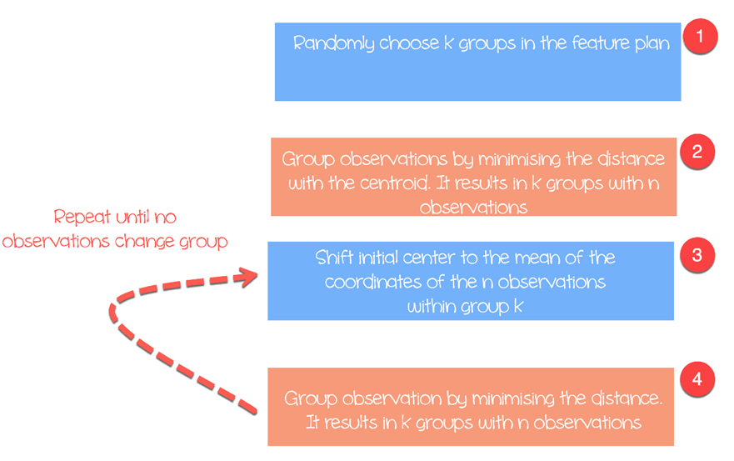

Slide 29
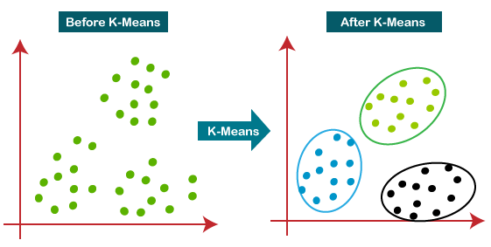
The below diagram explains the working of the K-means Clustering Algorithm:

Slide 30

The algorithm works as follow:
Step 1: Choose groups in the feature plan randomly
Step 2: Minimize the distance between the cluster center and the different observations (centroid). It results in groups with observations
Step 3: Shift the initial centroid to the mean of the coordinates within a group.
Step 4: Minimize the distance according to the new centroids. New boundaries are created. Thus, observations will move from one group to another
Repeat until no observation changes groups
K-means usually takes the Euclidean distance between the feature and feature :
Different measures are available such as the Manhattan distance or Minlowski distance. Note that, K-mean returns different groups each time you run the algorithm. Recall that the first initial guesses are random and compute the distances until the algorithm reaches a homogeneity within groups. That is, k-mean is very sensitive to the first choice, and unless the number of observations and groups are small, it is almost impossible to get the same clustering.

Slide 31

Selection of cluster
The number of clusters depends on the nature of the data set, the industry, business and so on. However, there is a rule of thumb to select the appropriate number of clusters:
with equals to the number of observation in the dataset.

Slide 32
Example
It is interesting to spend times to search for the best value of to fit with the business need.
We will use the prices of personal computers dataset to perform our clustering analysis. This dataset contains 6259 observations and 10 features. The dataset observes the price from 1993 to 1995 of 486 personal computers in the US. The variables are price, speed, ram, screen, cd among other.
You will proceed as follow:
Import data
Train the model
Evaluate the model

Slide 33
The working of the K-Means algorithm is explained in the below steps:
Step-1: select the number K to decide the number of clusters.
Step-2: select random k points or centroids. (It can be other from the input dataset).
Step-3: assign each data point to their closest centroid, which will form the predefined k clusters.
Step-4: calculate the variance and place a new centroid of each cluster.
Step-5: repeat the third steps, which means reassign each data point to the new closest centroid of each cluster.
Step-6: if any reassignment occurs, then go to step-4 else go to finish.
Step-7: the model is ready.

Slide 34
Supervised Learning | Unsupervised Learning
Supervised learning algorithms are trained using labeled data. | Unsupervised learning algorithms are trained using unlabeled data.
Supervised learning model takes direct feedback to check if it is predicting correct output or not. | Unsupervised learning model does not take any feedback.
Supervised learning model predicts the output. | Unsupervised learning model finds the hidden patterns in data.
In supervised learning, input data is provided to the model along with the output. | In unsupervised learning, only input data is provided to the model.
The goal of supervised learning is to train the model so that it can predict the output when it is given new data. | The goal of unsupervised learning is to find the hidden patterns and useful insights from the unknown dataset.
Supervised learning needs supervision to train the model. | Unsupervised learning does not need any supervision to train the model.
Supervised learning can be categorized in Classification and Regression problems. | Unsupervised Learning can be classified in Clustering and Associations problems.
Supervised learning can be used for those cases where we know the input as well as corresponding outputs. | Unsupervised learning can be used for those cases where we have only input data and no corresponding output data.
Supervised learning model produces an accurate result. | Unsupervised learning model may give less accurate result as compared to supervised learning.
Supervised learning is not close to true Artificial intelligence as in this, we first train the model for each data, and then only it can predict the correct output. | Unsupervised learning is more close to the true Artificial Intelligence as it learns similarly as a child learns daily routine things by his experiences.
It includes various algorithms such as Linear Regression, Logistic Regression, Support Vector Machine, Multi-class Classification, Bayesian Logic, etc. | It includes various algorithms such as Clustering, KNN, and Apriori algorithm.

Slide 35
Data in cluster analysis

Slide 36
Training And testing data
Training data
The observations in the training set form the experience that the algorithm uses to learn. In supervised learning problems, each observation consists of an observed output variable and one or more observed input variables.
Test data
The test set is a set of observations used to evaluate the performance of the model using some performance metric. It is important that no observations from the training set are included in the test set. If the test set does contain examples from the training set, it will be difficult to assess whether the algorithm has learned to generalize from the training set or has simply memorized it.

